Slide 1
Unions & The Fight Against Racism
Aboriginal & Workers of Colour Leadership

Slide 2
Birth of Industrial Unions
Great Depression
Corporate Power
Lack of Unionization
Racism

Slide 3
Racism in the US – 30’s and 40s
Notes:
Ask what people may know about the depth of racism in the US in the 30s. Then click to reveal the images.
At least 5,000 lynching deaths of African Americans are documented from the late 1800s to the 1960s. A quote from “Without Sanctuary” (p. 13) helps drive home how it was socially acceptable in ‘white’ society.
Context is important to understand the obstacles to union organizing during the Depression.

Slide 4
Strange Fruit
Notes:
Lynching was a focus of anti-racist organizing at the time.
Poem ‘Strange Fruit’ written by active member of the teacher’s union, Abel Meeropol, and first sung at a teacher’s union meeting by his wife Anne.

Slide 5
Ford Hunger March March 7, 1932
Notes:
1932 – before the United Auto Workers was founded, and all major industries, including the auto companies, were violently anti-union. It took courageous leadership to take on the battles.

Slide 6
Ford Hunger March
Among the banners:
Free the Scottsboro Boys
End Jim Crow
Notes:
Noteworthy that demands included workplace fundamentals, but also issues of community and social justice, most importantly a fight against racism.

Slide 8
Ford Hunger March
Dave Moore:
“It was the turning point in my life. The more I’d gotten involved in the Councils, the more I’d learned about the system …when I saw the blood flowing there on Miller Road, that was the point I became a radical. From that day on.”
Notes:
Follow up quotes from Moore interview, including mention of McKie.

Slide 9
Ford Hunger March
Bill McKie:
“It was the white workers who had to learn that the fight would have to be waged for black workers rights, for equality in the union, for black participation in union leadership.”
Notes:
Further quotes: Bates and Pettway, perhaps “Brother Bill McKie”.

Slide 10
Organizing Ford 1941
Notes:
As Dave Moore said, many of the organizers of the Ford Hunger March went on to join with the UAW and successfully organize GM and Chrysler. Then they turned their attention to Ford.
Crucial role of the many African-American workers at Ford – perhaps 12,000 of 90,000 at the River Rouge complex.
Point out the picket signs linking Ford and Hitler – ask why?

Slide 11
Henry Ford Receives the Grand Cross of the German Eagle, July 1938
Notes:
Hitler sent his emissaries to present this award to Henry Ford – it was the highest honour awarded by the government of Germany to non-citizens. Hitler had said in “Mein Kampf” – “Henry Ford is my inspiration”.

Slide 12
Ford 1941
90,000 workers at the Rouge complex
12,000 African-American workers
Henry Ford’s racist strategy
Hire African-Americans, but put them in the worst jobs, most brutal conditions
Hire through selected church ministers and elite of the community – control and loyalty
Pit white workers against African-American workers, to undermine union organizing

Slide 13
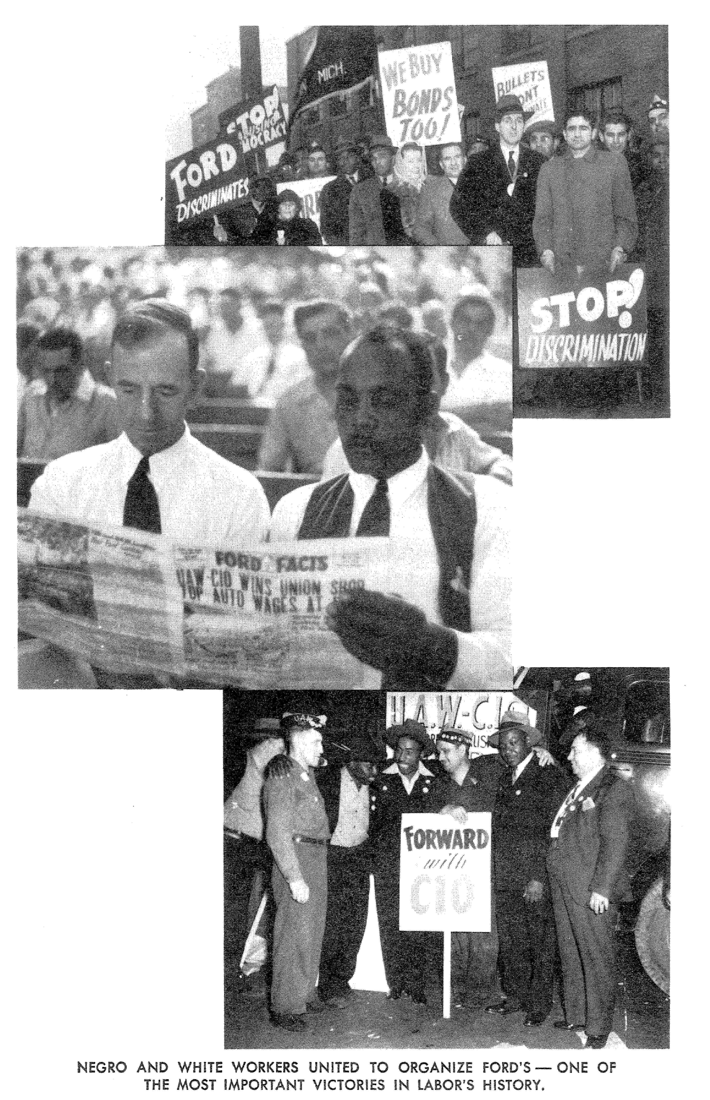
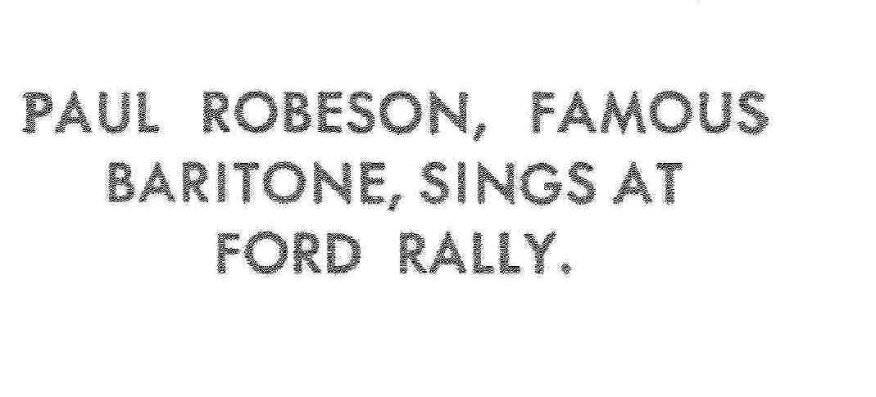
Organizing Ford 1941
Notes:
Second quote from Bates and Pettway.

Slide 14
1941
March – 2,000 more unemployed African-Americans hired
April 1, 1941 – spontaneous strike
April 2, am – picket line clashes
April 2, pm – about 1,000 leave the plant
April 3 – 400 workers sent out armed with 5 pound tractor tie rods, iron pipes and hammers, to attack the picket line

Slide 15
Ford 1941
What did Ford want to happen?
What do you think actually happened?

Slide 16
Notes:
Set-up the context – effort by Ford and the Service Department to spark race riots.
The union was able to overcome this racist strategy.

Slide 17
Was this the end of the issue of racism and division? Certainly not:
Debates continued in the union
Progress and setbacks
“Hate strikes”
Serious efforts to combat racism and educate white workers

Slide 18
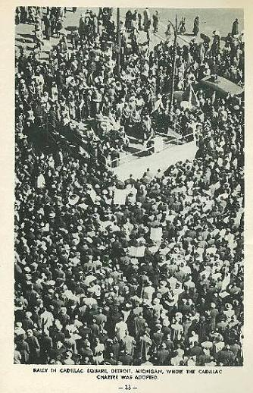
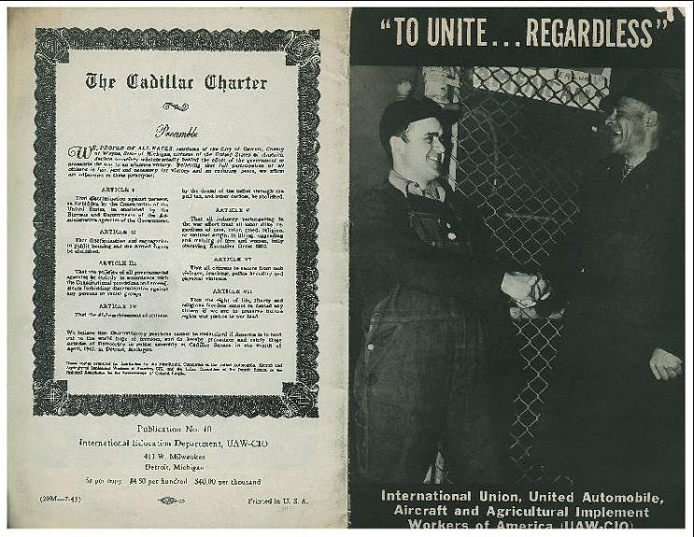
UAW “Cadillac Charter”
Notes:
The first contract with Ford included an anti-discrimination clause. But the UAW extended the fight against racism far beyond the workplace.
One of the incredible outcomes of the successful organizing drive at Ford was the public adoption of the ‘Cadillac Charter’. Read excerpts.

Slide 19
Organizing Ford 1941:
What made success possible?
History of anti-racist organizing
Left leadership

